Slide 1



On your MWB:
What do you remember about what happened to Maria?
If the police seized YOUR phone tonight, what could they find out about you? List 3 things.
Notes:
0-5 min. Quick recap of the Maria case, then the second question. Take a few answers to Q2 and ask students to keep their list: we come back to it in the plenary.

Slide 2

Messages
Topic Question
Lesson Question
How can digital artefacts be explored and analysed to reveal information about a person?
What is a brute force attack? What are VPNs, cookies, Internet search histories?
Notes:
Share the topic and lesson questions.

Slide 3






Computing
Digital Forensics
Lesson 7
How can instances of online grooming be avoided?
Computer Science
Aim
7
Information Technology
Lesson 5
How do we protect ourselves against unwanted attention online?
8
5
Online Safety
Lesson 8
What is my understanding of the lesson questions throughout this topic? & SRT
Lesson 4
How can a database be questioned?
4
Lesson 2
Do we really have privacy? Is our location always being tracked by the apps on our phones?
6
2
Lesson 6
What is a brute force attack? What are VPNs, cookies, Internet search histories?
Lesson 1
What data do digital devices store about their users?
3
Lesson 3
What are the ethical issues of online adverts? What is metadata?
1
Notes:
Where this lesson sits in the unit.

Slide 4

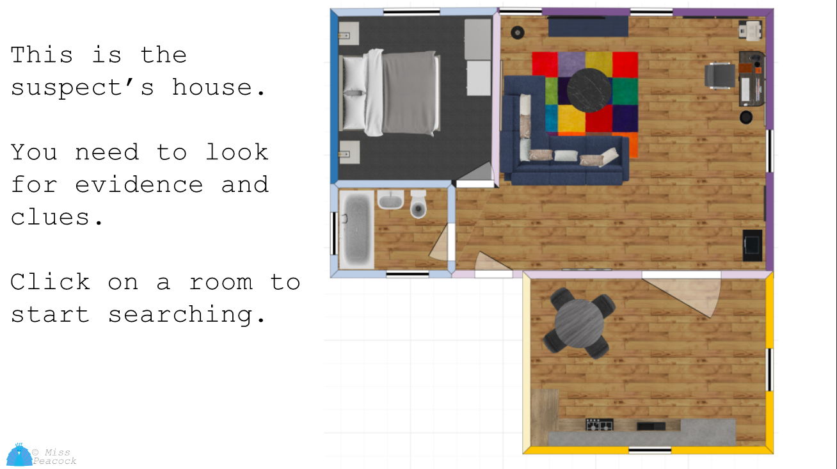

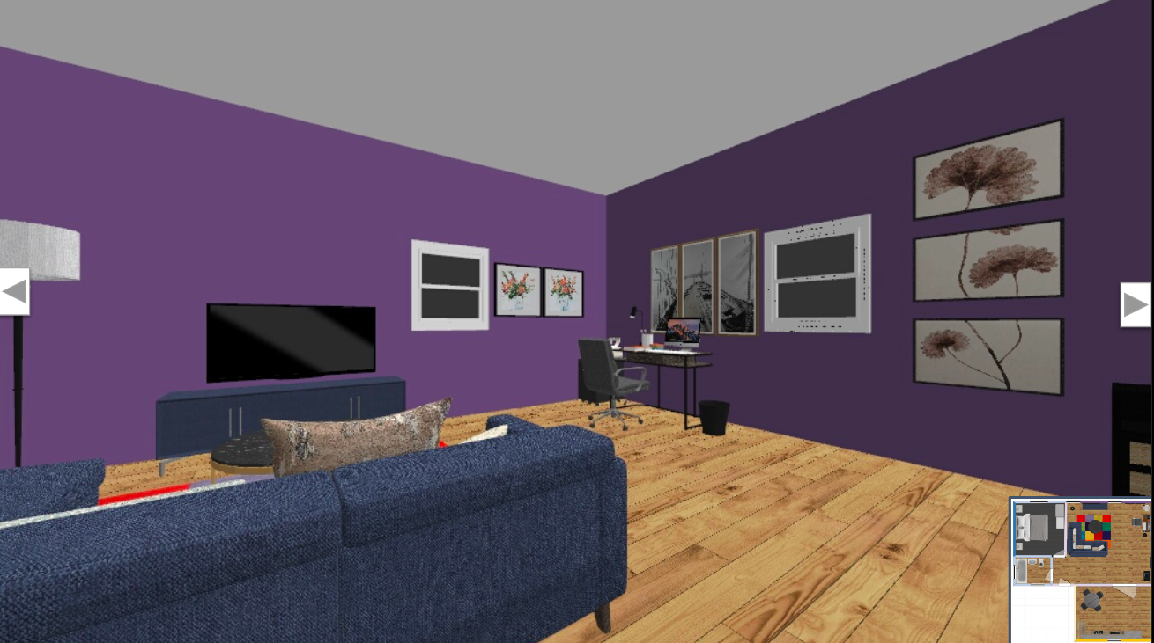


Recap & briefing
Last lesson you unlocked Ashley Williams's safe and computer.
Today you search his PC (Exhibit AW/02) and his phone (AW/03) for evidence.
Open "Searching the Computer" from Google Classroom.
Notes:
5-8 min. Students open the activity (Y9 > Cybersecurity > Searching the Computer). Stations unlock in order. Station 1 = brute force (8-18 min).

Slide 5



Get Digging
The files on the computer and messages on the Samsung phone
The digital forensic team have found files that show that Ashley Williams was stalking Maria for a substantial amount of time (before he even contacted her on instagram). The files included photographs of Maria and her friends at the shops and walking home from school.
These were taken using the Samsung phone found in the house.
Notes:
Context for the case before the stations. Then move straight to the red flags slide.

Slide 6
Red Flags
Obsessive behaviour: signs to look out for
Ashley's behaviour shows clear warning signs. None of this is normal, romantic or OK:
Fixating on one person and wanting to know where they are and what they are doing
Taking photos of someone without their knowledge
Creating fake accounts to get close to someone or their friends
Pushing someone to keep chats secret, or getting angry when they do not reply
If you notice any of these towards you or a friend: do not reply, screenshot it, block, and tell a trusted adult. You can also report to CEOP (ceop.police.uk).
Notes:
Safeguarding moment. Be explicit that these are red flags, not compliments or "being keen". Signpost: trusted adult, DSL, CEOP. The same red-flags card appears in Station 2 of the activity.

Slide 7
Pause point 1
Station 1: Crack the Login
Discuss with your partner:
Why did Ashley's password fall in just 2 guesses?
Why would 'kettle tiger purple moon' take millions of years to crack?
Which defence would have stopped the attack completely?
Then carry on with Station 2: Browser Forensics
Notes:
18-20 min. Answers: the clues cut the guesses from 54 to 2; length makes the number of combinations enormous; 2FA or lockout. Then Stations 2 and 3 (20-40 min).

Slide 8
Pause point 2
Stations 2 & 3: history, cookies and deleted files
Ashley cleared his history and emptied the Recycle Bin.
Why didn't that hide anything?
What actually happens when you delete a file?
What should you do before selling your old phone?
Then carry on with Station 4: The Unpatched Phone
Notes:
40-42 min. Clearing history and emptying the bin only removes the file table entries; the data stays until it is overwritten, so investigators can carve it back. Before selling: back up, encrypt, factory reset. Then Station 4 (42-50 min).

Slide 9
Get Digging
The unpatched Samsung phone
The Samsung phone (Exhibit AW/03) was locked with a PIN. Its last security patch was 1 March 2023.
A hole that lets someone get past the lock screen was fixed in June 2023, so it was still open on Ashley's phone. With a warrant, the police lab used it to get in.
Inside were the fake Instagram accounts, the messages to Maria and the original photos.
What is a security patch? Why should you install updates as soon as they arrive?
Notes:
Station 4 context. A patch fixes a security hole; once it is released, everyone (criminals too) knows the hole exists, so unpatched devices are an open door. The police only did this with a warrant; doing it to someone else's device is a crime under the Computer Misuse Act 1990. Ask: who else could use that hole on Ashley's phone? (Anyone who steals or finds it.)

Slide 10
Finished? Breach Defence
Extension: class challenge
When your case report is filed, open Breach Defence.
Choose Class challenge and type the code: CYBER6
Everyone with the code gets the same threats in the same order
Best defence + speed + streaks = big score. Three breaches and you are out
Highest score by the end of the lesson wins!
Notes:
Show this from about 50 min onwards for finishers. Change the code for each class (any letters/numbers) so classes cannot share runs. Ask for the top three scores at the end.

Slide 11
Digital Forensic Investigators-what do they search for?
They will examine a device very closely. They may analyse the following (not an exhaustive list):
The hard drive - what files are on the hard drive but also what files
have been purposefully destroyed - they use specialist software for this.
Internet search history, cookies and any temporary files. What the suspect has been searching can be very important in an investigation.
Location settings - Have any apps stored the location?
The device's software - an out-of-date phone may have known security holes that let investigators past the lock screen.
Other data - there is loads more data that our devices collect about us i.e health data.
Notes:
Summary of what investigators look for. Hard drive = Station 3, history and cookies = Station 2, software and patch level = Station 4.

Slide 12
Plenary
Look back at your Do Now list
If the police seized your phone tonight, what could they find?
Which of those could you protect, and how? Are any of your devices waiting for an update?
Which ONE action will you take this week?
Which red flags would make you tell a trusted adult?
Then answer the lesson question on your MWB
Notes:
55-58 min. Link back to the Do Now lists and the Protect Yourself choices from the case report.

Slide 13

What is a brute force attack? What are software updates, cookies and internet search histories?
Notes:
58-60 min. MWB exit: one sentence for each term.

